Slide 1

CookConnect:A Recipe Sharing Application
Presented by:
Diya Khandelwal, R2142210293, DevOps
Akshay Mohpal, R2142210078, DevOps
Gaurav Bhandari, R21422210311, DevOps
Kanishka, R2142210393, DevOps
Under the guidance of:
Mr Sandeep Pratap Singh
School of Computer Science

Slide 2
1.Introduction
In a world driven by digital connectivity and a shared love of culinary delights, recipe-sharing apps have arisen as a game-changing tool for foodies to connect, create, and celebrate the art of cooking.
These platforms' overall success is attributed to its seamless navigation, visually appealing interfaces, and ability to seamlessly engage with other users.
This synopsis will delve into the project's core elements, exploring data representation, algorithmic implementation, real-time adaptability, and user interface design.

Slide 3
2.Motivation
The purpose is to provide useful insights into the world of recipe sharing applications, emphasizing its importance in establishing culinary communities, stimulating innovation, and altering how people experience and share their love of food.

Slide 4
3.Related Work
Yummify: It is a Recipe Sharing App built on the MERN stack that aims to ease the culinary experience for users globally. It has a large recipe collection, personalized user accounts, and a streamlined user interface. Yummify usage of React.js assures a responsive and entertaining frontend, while its strong backend, built with Node.js and Express.js, handles user authentication and recipe administration effectively.
CulinaryConnect: It is a Recipe Sharing App aimed at professional chefs and culinary aficionados. It is built with MongoDB, Express.js, React.js, and Node.js, and it allows chefs to display their skills and communicate with other users. The app's React.js frontend allows for smooth navigation, while the backend manages safe user login and recipe administration.
FlavorNet: It provides a new approach to Recipe Sharing by using machine learning algorithms to provide personalized recipe recommendations. This MERN stack application uses MongoDB to efficiently store and retrieve data, and its React.js frontend provides users with a visually appealing and intuitive interface. FlavorNet promises to increase user engagement by providing intelligent recipe ideas based on personal tastes.

Slide 5
4.Problem Statement
Developing a robust and innovative recipe-sharing application that focuses on community building, user-friendly interfaces, seamless recipe sharing, enhanced social interactions, and user empowerment. The goal is to build a dynamic digital platform that not only acts as a repository for cooking creativity, but also fosters a vibrant global community of food enthusiasts by providing them with the tools and services they need to connect, share, and empower one another on their cooking adventures.

Slide 6
5. Objectives
User Authentication with Passport.js: Implement user registration and login using Passport.js authentication.
Deployment with Amazon EKS: Containerize your application with Docker to ensure consistency and portability.
Recipe Management and Search Functions: Allow users to create, amend, and remove recipes using a sophisticated text editor.
Favorite List and User Profile: Create a feature that allows users to add recipes to their favorites list.

Slide 7
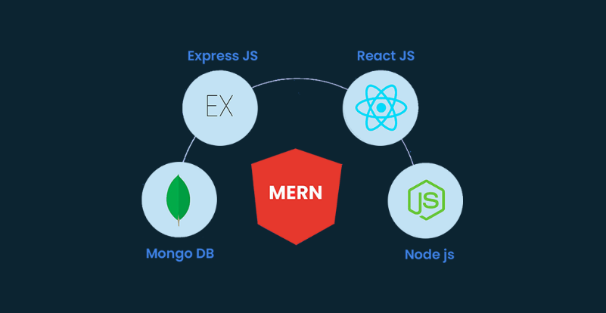
Tech Stack
Frontend:React js
Backend: node js and express js
Data base: Mongodb
Version control: Git
Deployment: amazon Elastic kubernetes service

Slide 8
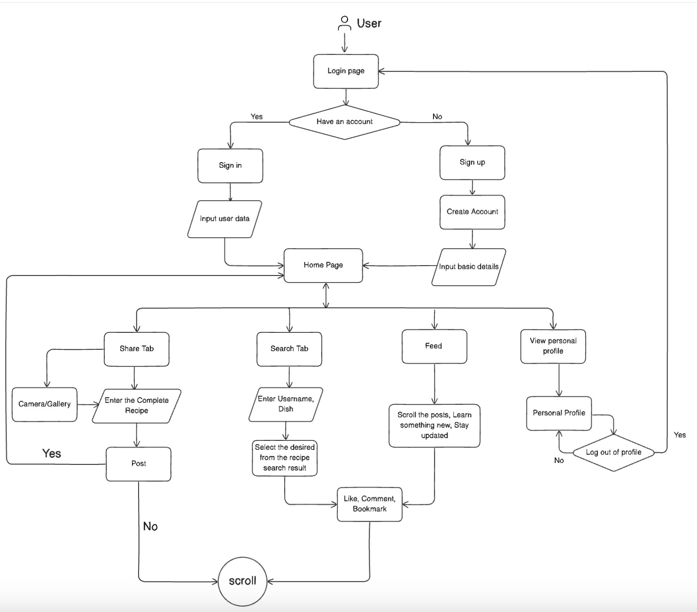
6.Proposed methodology

Slide 9
8.Problems in Model
Community Engagement
User Interface Complexity
Content Quality Control
Technical Performance
Privacy Concerns
Continuous Improvement

Slide 10
5. SWOT
Strengths:
Content Variety: The ability to share diverse recipes, including user-generated content, can attract a wide audience and keep the platform content-rich.
Weaknesses:
Feature Complexity: Introducing too many features or a complex user interface could overwhelm users and hinder their experience. It's important to strike a balance between functionality and simplicity.
Opportunities:
Collaborations with Chefs: Partnering with professional chefs or culinary influencers to contribute content or collaborate on special features can enhance the platform's credibility and attract a broader audience.
Threats:
Competitive Platforms: The presence of well-established recipe-sharing platforms or new entrants with similar features could pose a threat to gaining and retaining users.

Slide 11

Thank You

